Slide 1
Parking Palooza
Peter VanDerKolk, Jonah Casimir, Seth Julien
2017 FBLA National Leadership Conference
Notes:
Hi, my name is Peter VanDerKolk, (then Jonah and Seth say their names), we are students at Xavier High School here in Appleton, and today we will be presenting to you, Parking Palooza

Slide 2
The Challenge
Make it simple, entertaining, and engaging
Easy concept
Increasing Difficulty
Fun to play
Notes:
Controls - WASD or Arrow Keys Objective is defined in short, easy to read sentences before each level Easy to grasp concept
Levels get harder - more hazards, less time Fun to play, engaging Decision making - Trial and error, compensating for drift

Slide 3
Planning Process
Identified the challenge
Brainstormed ideas
Started the programming
Designed the presentation
Notes:
Brainstormed ideas - list other ideas Frequent meetings, often talked at the lunch table about plan, spent time outside of school programming and making the presentation
Programmed and designed the game, made the levels, etc. Designed the presentation, decided who would explain which things

Slide 4

Software Selection
Unity
Free
Open Source
Easy to learn
Notes:
Jonah

Slide 5
User Interface
Input
Easy to use controls
Interchangeable controls
Can choose pace of levels
Output
Simple graphics
Backwards compatible
Notes:
Talk about the controls, more than just the WASD WASD or Arrow Keys Pace of levels - can choose timed or untimed Simple graphics, runs smoothly Backwards compatible?

Slide 6
User Interaction
Entertaining
Fun, but simple to follow
Engaging
Simple concept, allows user to focus on the game
Gradually increases in difficulty
Notes:
Timing/spatial relationships - drifting, turning correctly; can I get the stars before parking

Slide 7
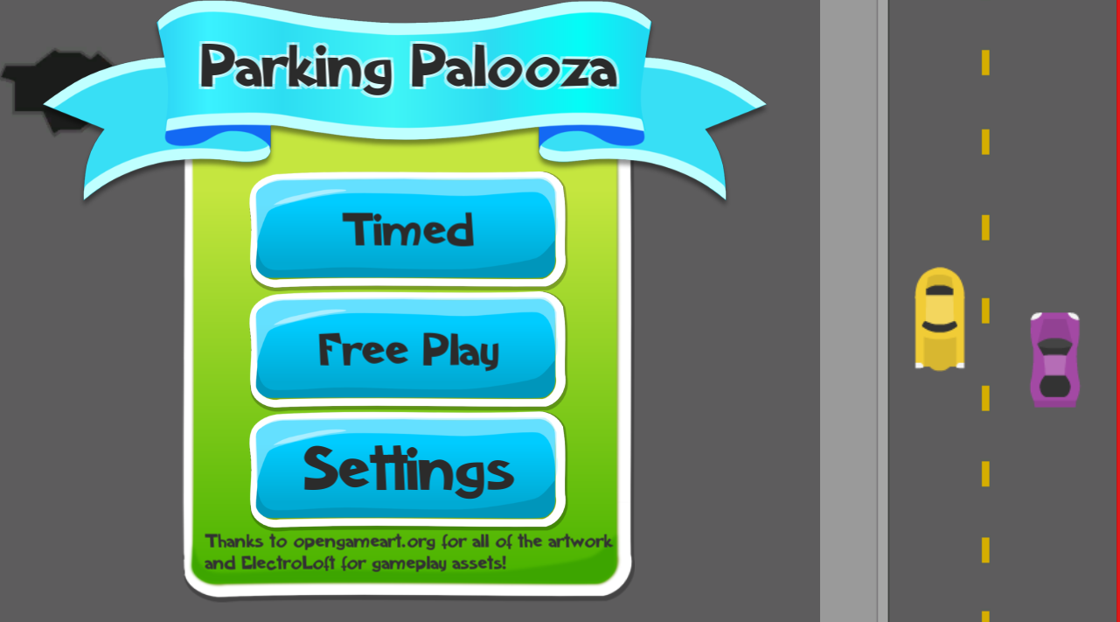
Parking Palooza
Add a picture of the game here?
Notes:
Thank you for listening to our presentation on Parking Palooza. Are there any questions about the game?

Slide 8
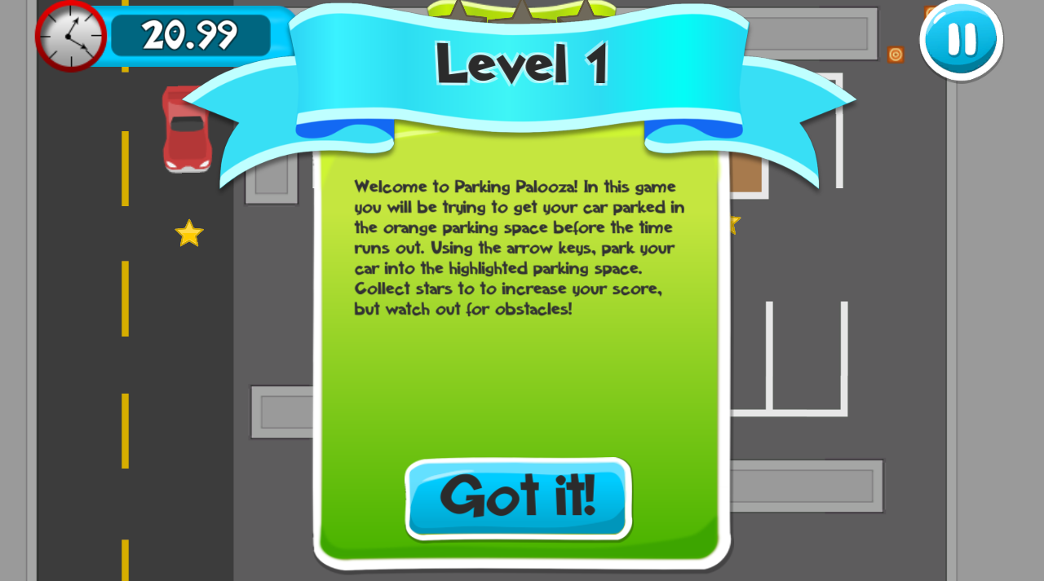

Slide 9
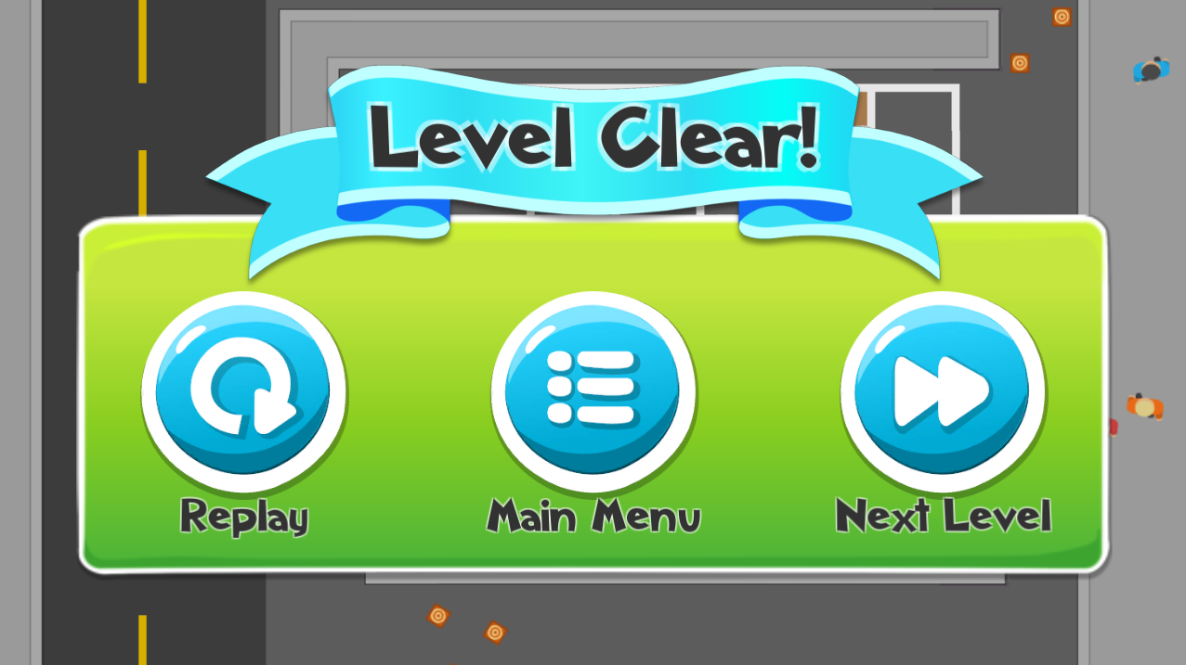

Slide 10
Inside Parking Palooza
Modules
Prefabs
Comments
Debugging
Understandability
Structure
Scenes
Notes:
New challenges - pedestrians, other cars, oil, cones, holes in the road Objective is explained for the first level, stays the same throughout, New hazards are defined before each level
Knowledge of previous hazards assists in later levels Coding stuff

Slide 11
Usefulness in Education
Helps decision making
Builds good driving habits
Playable by any age
Simple wording
Notes:
Get a feel for the keyboard Anyone can play Decisions - can I make this turn? Do I have time? Should I park or get the stars? Motor control skill, hand-eye coordination

Slide 12
Final Thoughts
Brainstorming
Testing is vital
Possible Changes
Difficulty scaling
Fix drift bug

Slide 13
Thank you!

